Slide 1

Mass Create
Introductory Training
October 2020

Slide 2

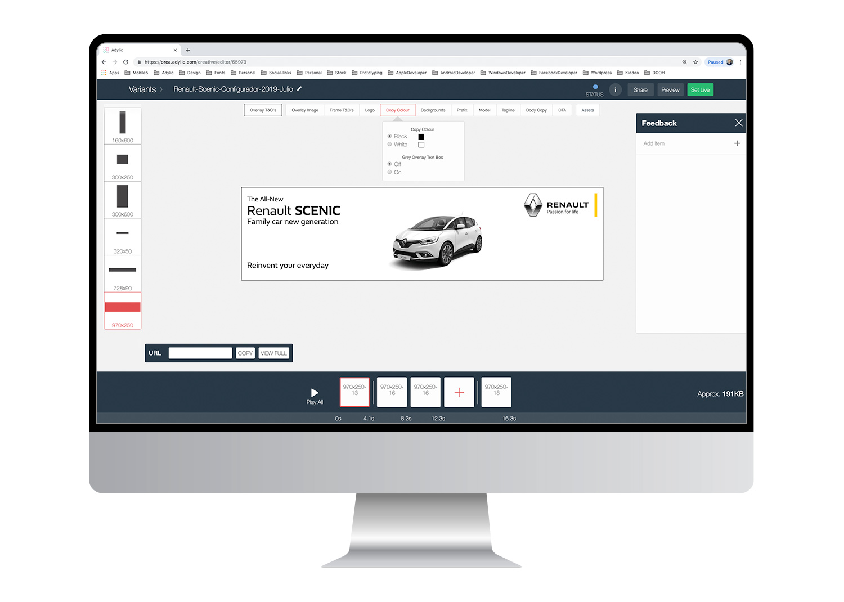
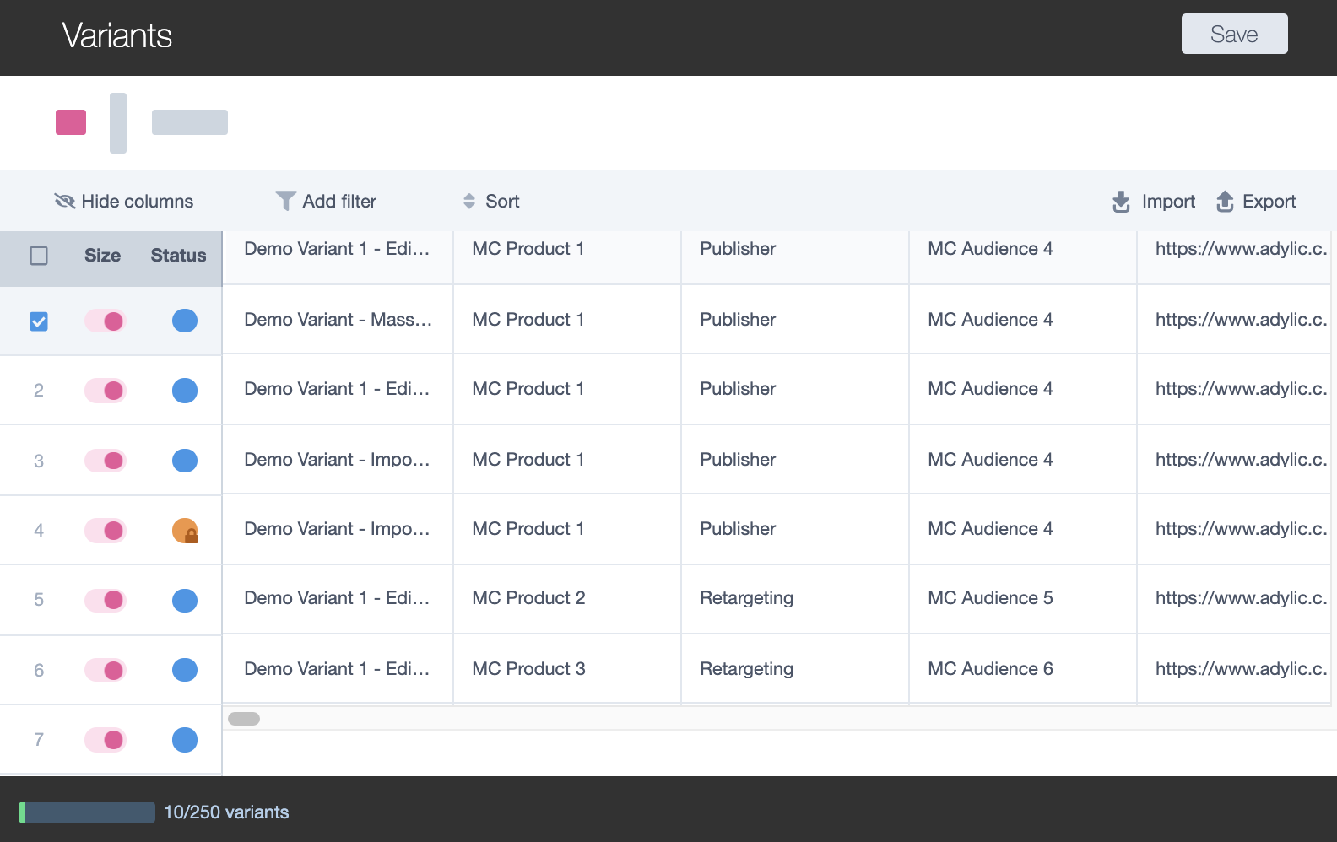
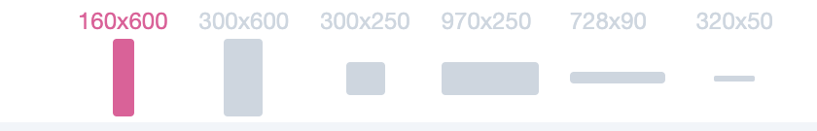


Platform Training Doc
Mass Create Introduction
In Orca, variant creation and editing has only been available one variant at a time; until now! You can now both create and edit up to 250 variants in a single session. The following document will walk you through the new features that have been released to enable this new, faster way of working and help get you up and running!
Document Sections:
1 LOGGING IN
2 MASS DUPLICATE
3 MASS EDIT
4 FEATURE MAP
5 - 13 GRID WORKING
14 FAQs
15 USER RESOURCES
16 SUPPORT
Useful Info:
TRAINING: Where you see this icon, it indicates that there are additional training resources available for this process. Please refer to section 15 to see a full list of resources available.
TOP-TIPS: Throughout the document we’ve included some useful tips, which are highlighted using this icon!

Slide 3
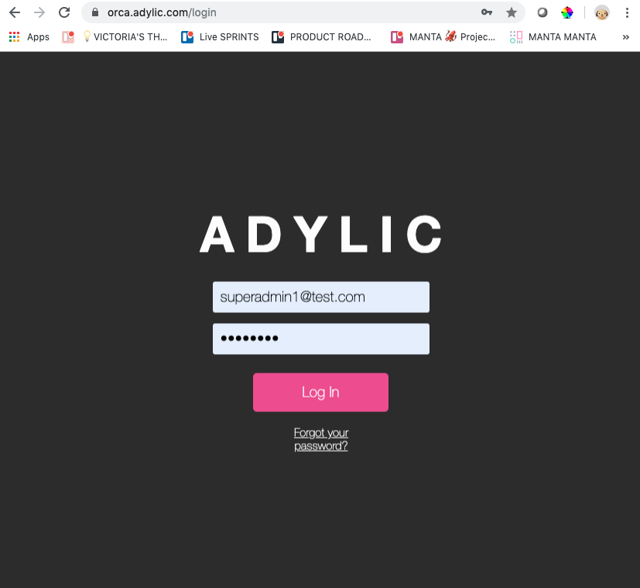
Getting Started
Logging In
First things first, the Orca platform can be found here: https://orca.adylic.com/login
You should already have logins for Orca. However, if you don’t and you think you need one*, you’ll need to speak to your Adylic Account Manager to get you set up.
If you login and something doesn’t look right, make sure your AdBlock is OFF. Also, if you haven’t cleared your cache in a while, try emptying that and trying again.
1
2
Mass Create functionality is for ‘Creator’ roles only. If you currently aren’t set up with ‘Creator’ permissions, you should also speak with your Adylic Account Manager.
TIP

Slide 4
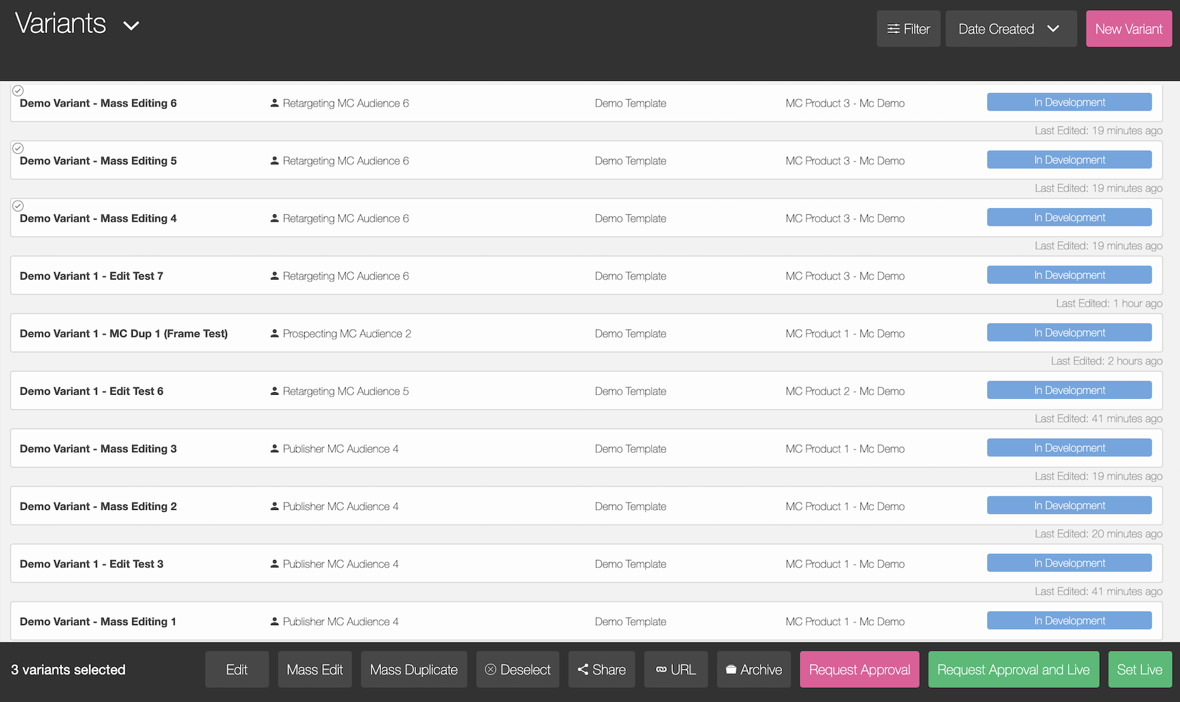
Workflows
Full user guide &
video available!
Mass Create
Within Orca, you will now have access to a new workflow, which allows you to create and edit sets of variants in the click of a button:
Go to the Orca table page https://orca.adylic.com/table
In the table page, you can select multiple variants using the ‘check-box’ on each variant listing
Within the multi-select options footer bar, you will see the ‘Mass Edit’ and ‘Mass Duplicate’ action buttons.
Selecting either of these options, will take you into the Mass Create Grid View
2
Due to the nature of grid working, Mass Duplicate workflow is only available when selecting variants with the same Template & Frame structure.
3
TIP

Slide 5
Workflows
Full user guide &
video available!
Mass Edit
Mass Create can be used to edit multiple variants in bulk at the same time.
NOTE: Due to the nature of grid working, Mass Edit workflow is currently only available when selecting variants with the same Template & Frame configuration.
Workflow:
Go to the Orca table page https://orca.adylic.com/table
In the table page, you can select multiple variants using the ‘check-box’ on each variant listing
Within the multi-select options footer bar, you will see the ‘Mass Edit’ action button
Selecting this option, will take the set of the variants you have selecting into the Mass Create Grid View to edit…
2
3

Slide 6
Workflows
Full user guide &
video available!
Mass Duplicate
Mass Duplicate can be used to duplicate multiple variants at the same time. This feature will duplicate each selected variant once.
NOTE: Due to the nature of grid working, Mass Edit workflow is currently only available when selecting variants with the same Template & Frame configuration.
Workflow:
Go to the Orca table page https://orca.adylic.com/table
In the table page, you can select multiple variants using the ‘check-box’ on each variant listing
Within the multi-select options footer bar, you will see the ‘Mass Duplicate’ action button
Selecting this option, will create a duplicate set of the variants you have selecting and take you into the Mass Create Grid View.
2
Enter Mass Edit first and duplicate from there if you want to duplicate and edit existing variants.
3
TIP

Slide 7
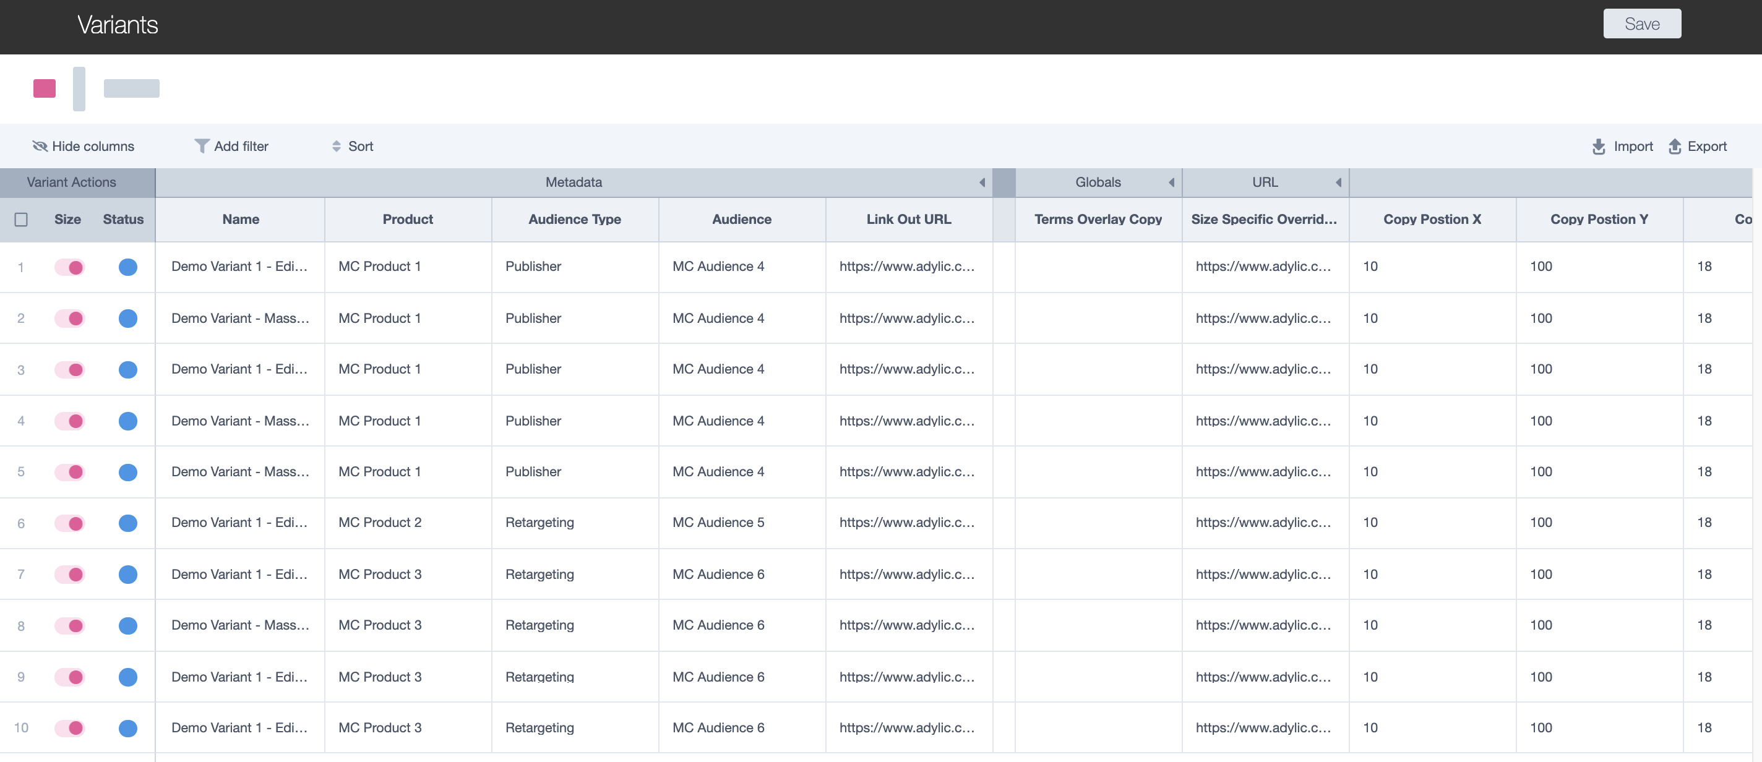

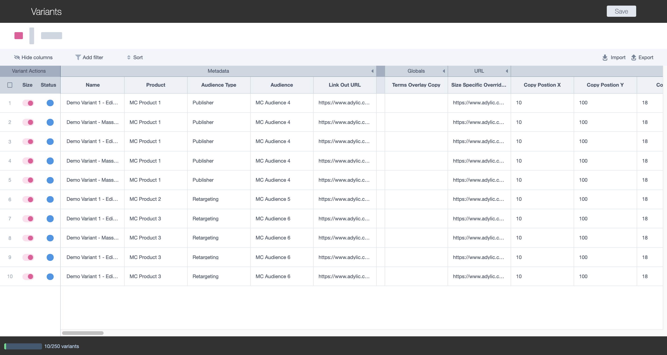
Mass Create Grid View
4a
In the example shown:
The row shows shows the variant names ‘Variant 4 [duplicate]’
The Column highlighted is for the ‘Audience Type’
Therefore, editing the cell highlighted would update the ‘Audience Type’ for ‘Variant 4’
a) The example shows 160x600 is currently being edited.
b) 160x600 is currently switched off for 'Variant 1’.
2
4b
3
1
Grid Layout
When you enter Mass Create (MC) you will see a table. We refer to this as the Mass Create Grid. The grid is structured in a standard table format, where:
Each row represents a creative variant
Each column represents an editable field or a dynamic element within your template
Each cell contains the value for that field (column) and the corresponding variant (row).
All available sizes are shown above the mass create grid, with the ability to turn them on and off per variant.
Grid Layout
When you enter MC (Mass Create) you will see a table. We refer to this as the Mass Create Grid. The grid is structured in a standard table format, where:
Each row represents a creative variant
Each column represents an editable field or a dynamic element within your template
Each cell contains the value for that field (column) and the corresponding variant (row).
Notes:
UPDATES:
Check Frames hidden
Change screenshot to generic client view
Update with ORCA nav bar

Slide 8
Mass Create Grid View
In the example shown:
Metadata fields will always sit on the left side of the grid.
Template feature fields will always sit on the right side of the grid with global features first.
The example shows a text field with size specific URLs and a numeric field for copy x positioning.
1
2
3
Grid Layout
Mass Create grid is also split out in variant settings (Metadata) and template features.
Metadata fields are variant settings such as the variant name, the audience it’s assigned to etc.
Template feature fields represent the features you would find in the template menu when editing a single variant. These will be split into Global and frame specific features.
Each cell will be edited either be a numeric field referencing x/y positioning and sizing or a text field referencing copy.
Grid Layout
When you enter MC (Mass Create) you will see a table. We refer to this as the Mass Create Grid. The grid is structured in a standard table format, where:
Each row represents a creative variant
Each column represents an editable field or a dynamic element within your template
Each cell contains the value for that field (column) and the corresponding variant (row).
Notes:
UPDATES:
Check Frames hidden
Change screenshot to generic client view
Update with ORCA nav bar

Slide 9
Mass Create Grid View
9
4
5
13
12
11
10
Mass Create Feature Map
Within the MC grid, you will find the following features:
2
Select box
Variant Sizes
Hide Columns
Filter
Sort
Variant Count
Size ON/OFF
Status Indicator
Exit link
Save button
Export button
Import button
Collapse Columns
3
1
7
8
6
Notes:
UPDATES:
Check Frames hidden
Change screenshot to generic client view
Update with ORCA nav bar

Slide 10
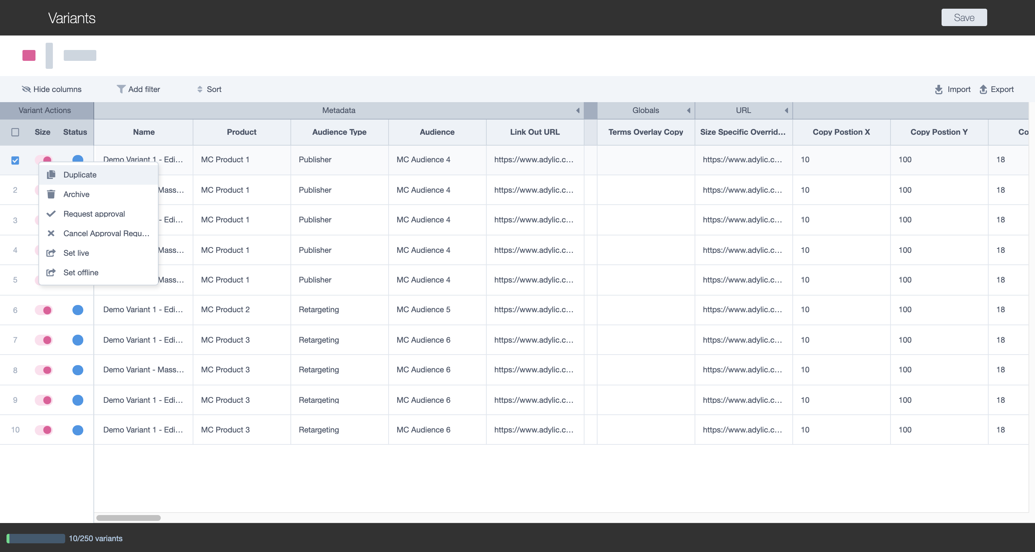
Mass Create Grid View
Full user guide &
video available!
Adding Variants
Creating new variants in the MC grid is easy! You can take a direct copy of any variant, or multiple variants, using the ‘Duplicate’ action:
Select the variants you want to copy, using the ‘select’ check-box button
Right-click on the variant action area on the far left of the grid
Select ‘Duplicate’ action
See your rows duplicated in the table, as new variants
1
2
3
4
When duplicating a row, you are copying the saved version of your variant. If you have unsaved changes in the grid, you should save before duplicating. Please see the ‘Saving’ FAQ for more info.
TIP

Slide 11
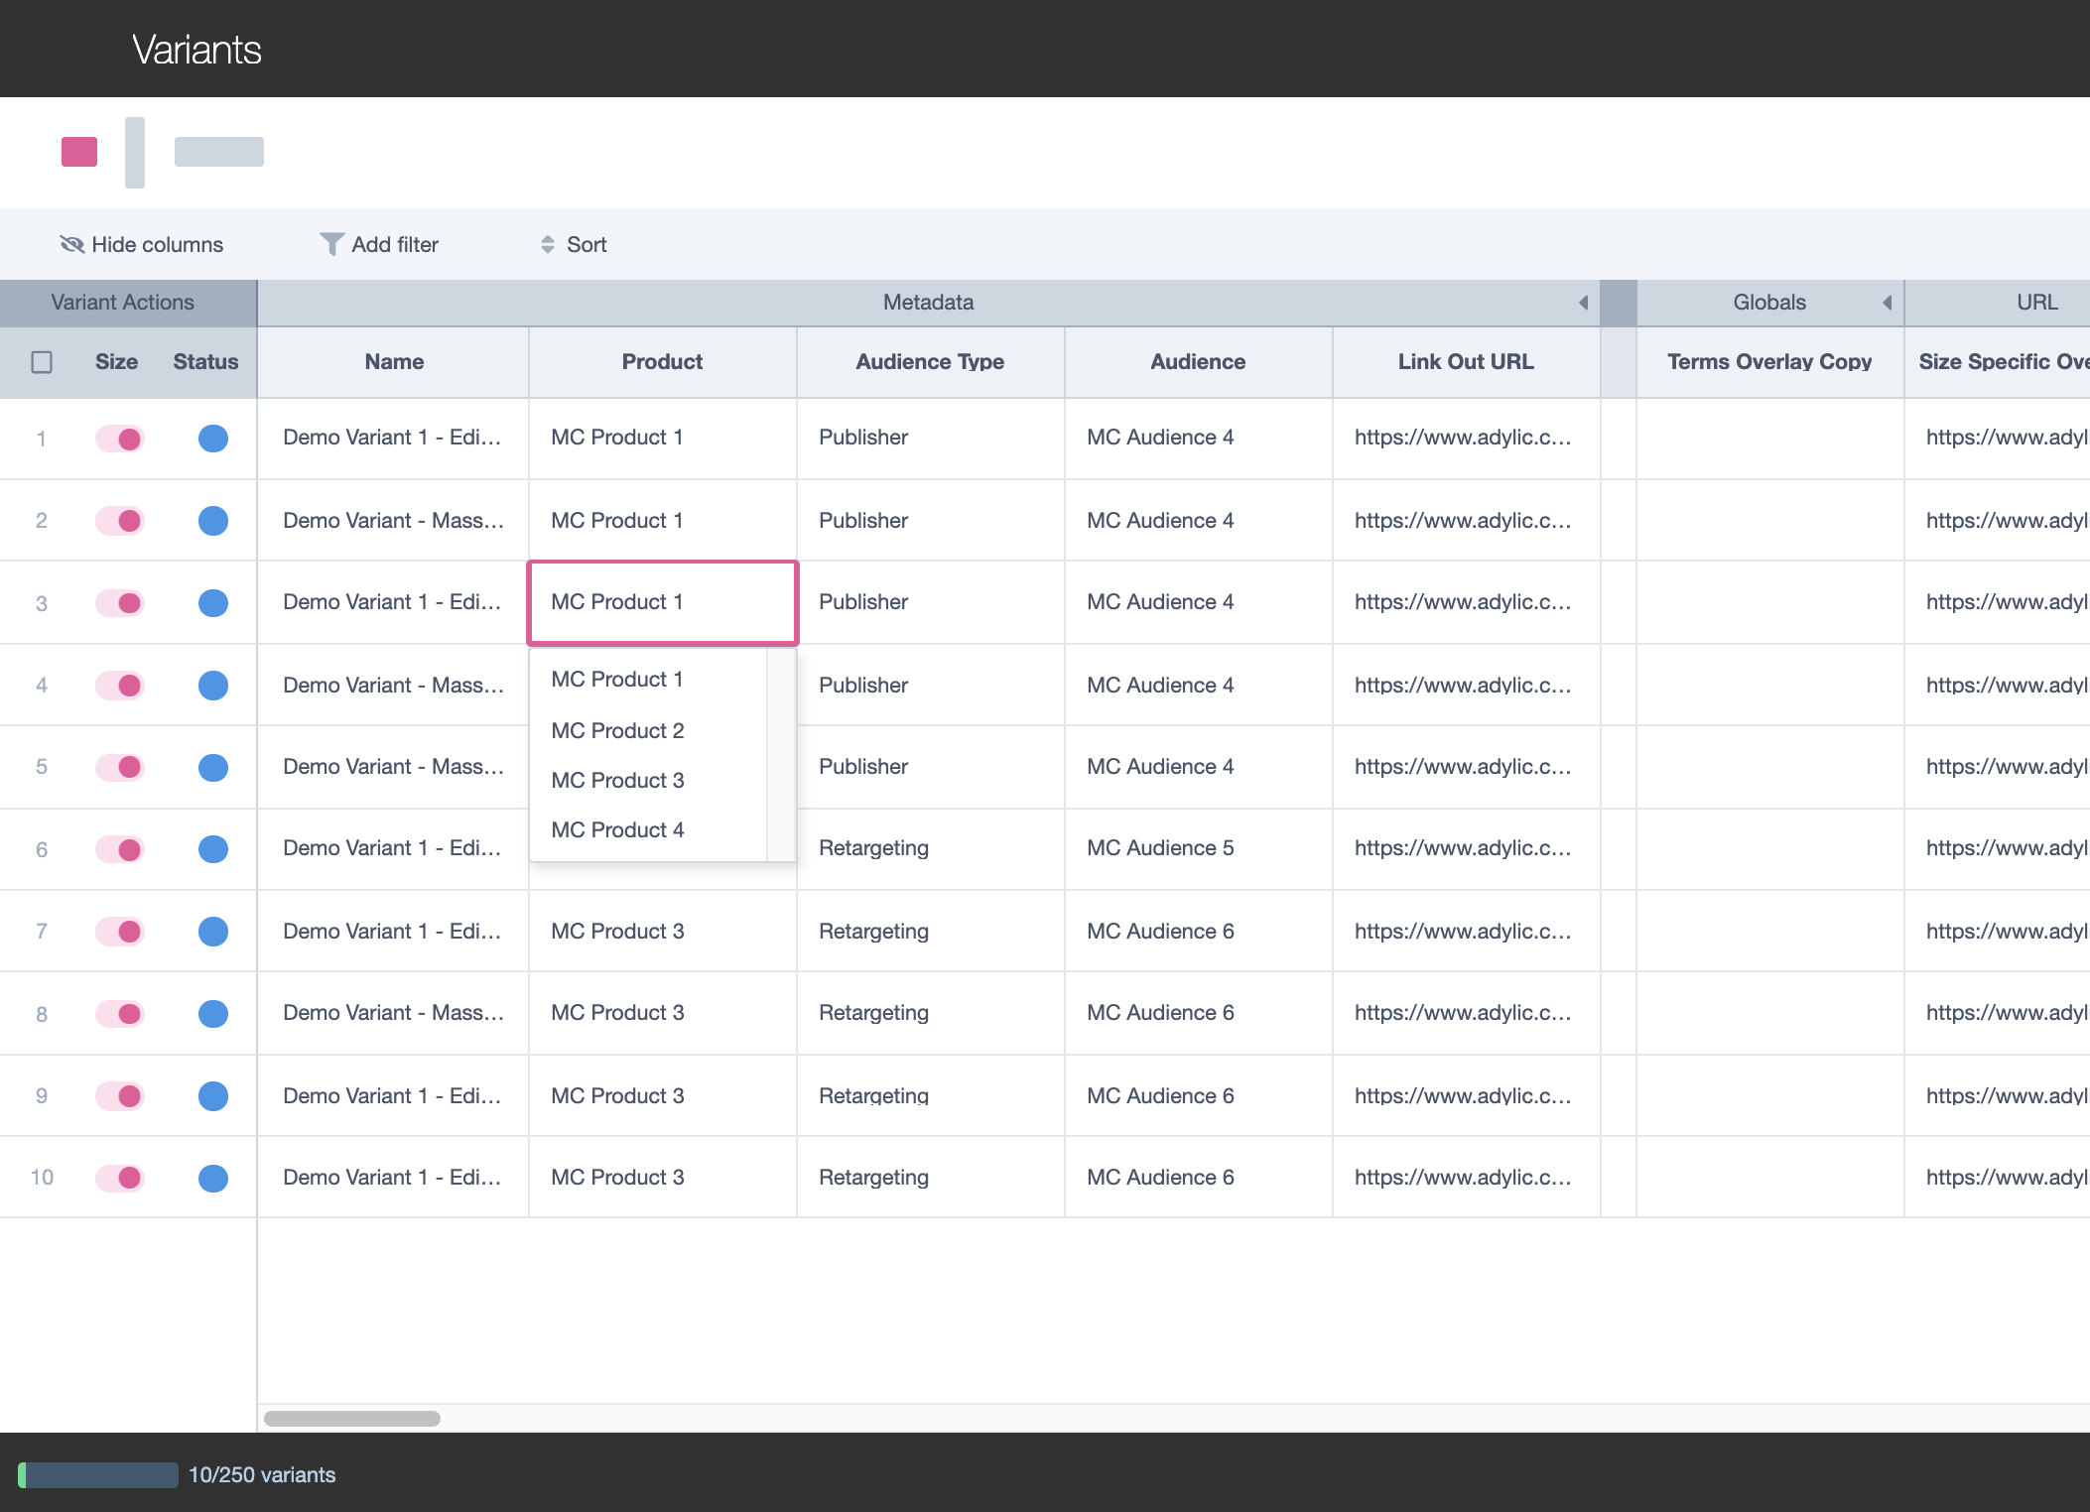
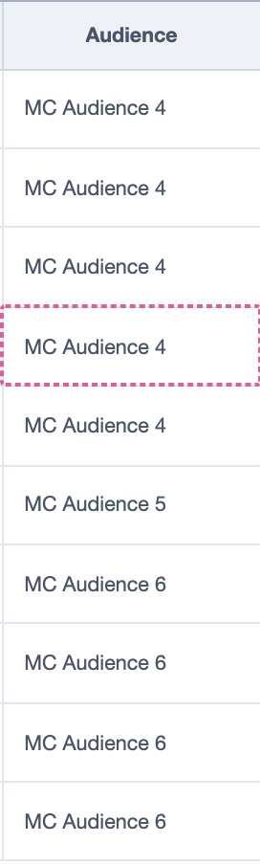
Mass Create Grid View
Editing Values
To edit your variants, you simply need to change the value in the cell to a new one! You can do this in one of the following ways:
Direct Cell Input: Select the cell containing the value you want to change. Depending on the type of data you are inputting, you can either select or type in the new value
Copy/Paste:
  Select the cell containing the value you want to copy and right click (or CTRL/CMD+C) to see the cell has been copied (dotted outline surround the cell)
  Now select the cell you want to paste your value into and either right click (or CTRL/CMD+V) to paste the new value into the cell
1
2
When using the copy feature, you can also multi-select cells to paste into by dragging your selection down the column.
TIP

Slide 12
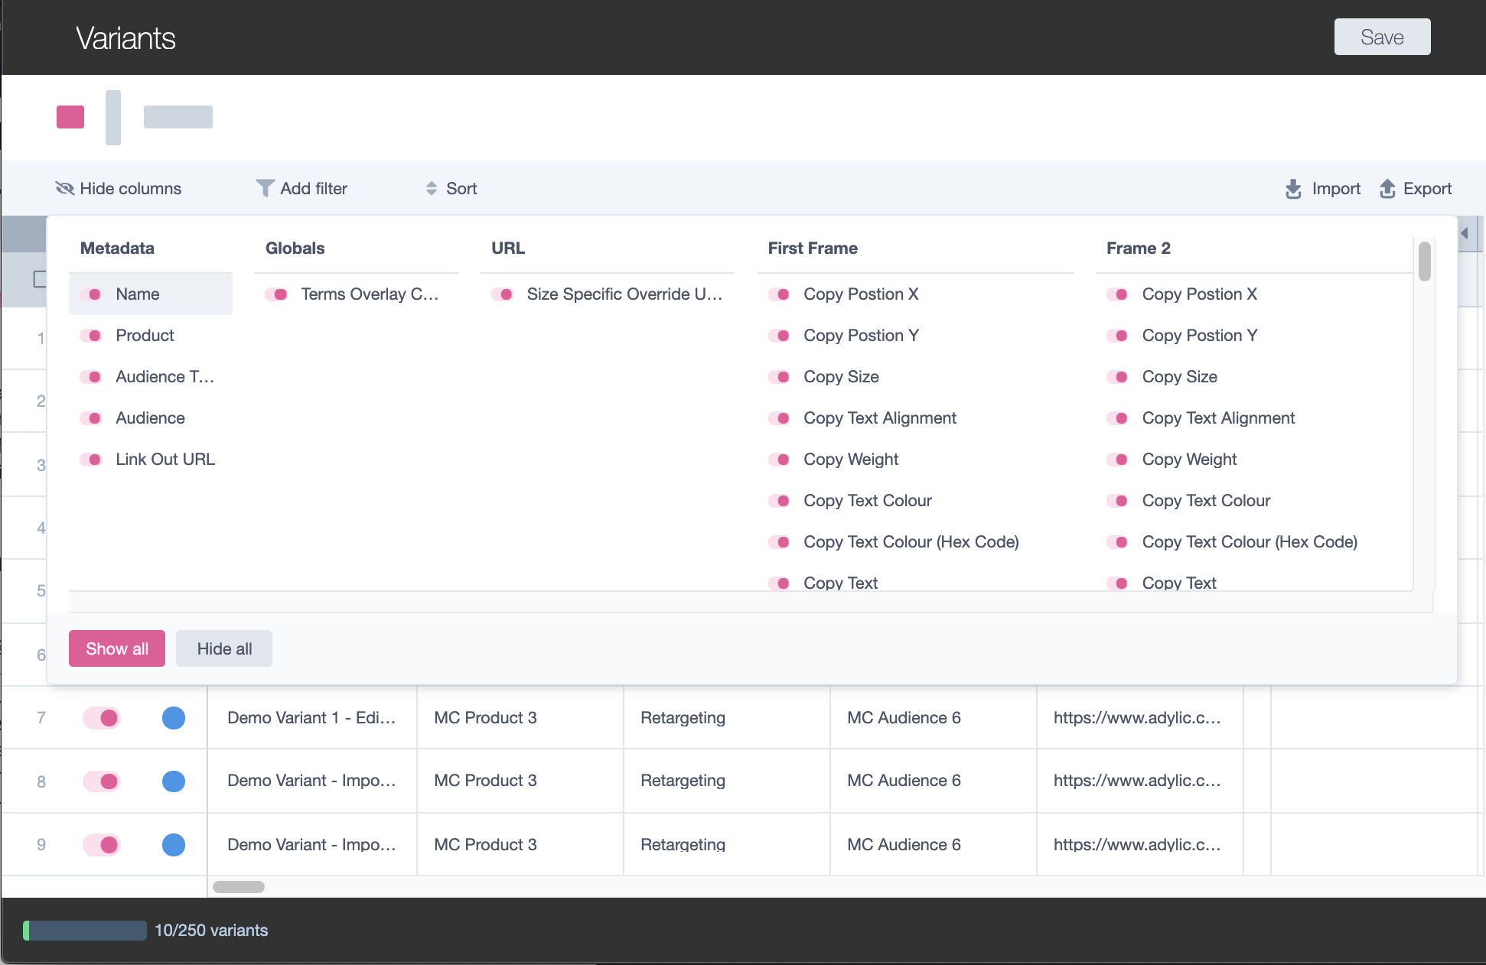
Mass Create Grid View
Full user guide &
video available!
Managing Columns
For many templates, the MC grid is quite big and in reality, you are likely only going to be editing a selection of dynamic variables. Therefore, it can be useful to manage your columns so you can only see the ones you are interested in. There are two MC features that will allow you to do this:
1
1
Option 1: Hiding Columns
Select the ‘Hide Columns’ button in the header bar
Toggle ON/OFF column boxes to show/hide columns respectively
You can also use the ‘Show all’ or ‘Hide all’ buttons to speed this up
See that your OFF columns are now hidden from view and just return to the ‘Hide Columns’ button when you want to un-hide these columns again!
2
3

Slide 13
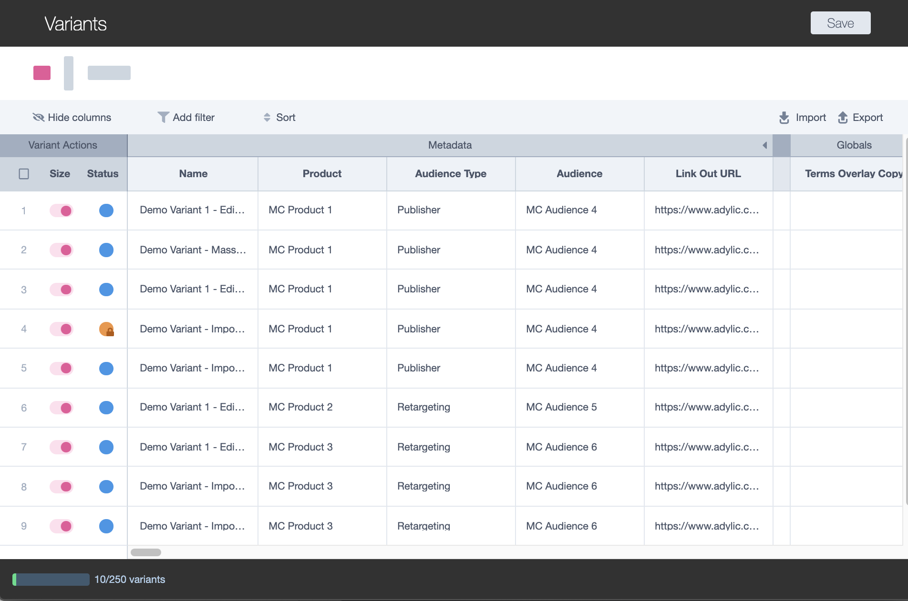
Mass Create Grid View
Full user guide &
video available!
Managing Columns
For many templates, the MC grid is quite big and in reality, you are likely only going to be personalising a selection of dynamic variables. Therefore, it can be useful to manage your columns so you can only see the ones you are interested in. there are two MC features that will allow you to do this:
1
Option 2: Collapsing Column Groups
Scroll to the far right of a column group header bar
See a small carat icon and select this button
See that all columns within this column group are now hidden
Select the carat icon again when you want to un-hide these columns again

Slide 14
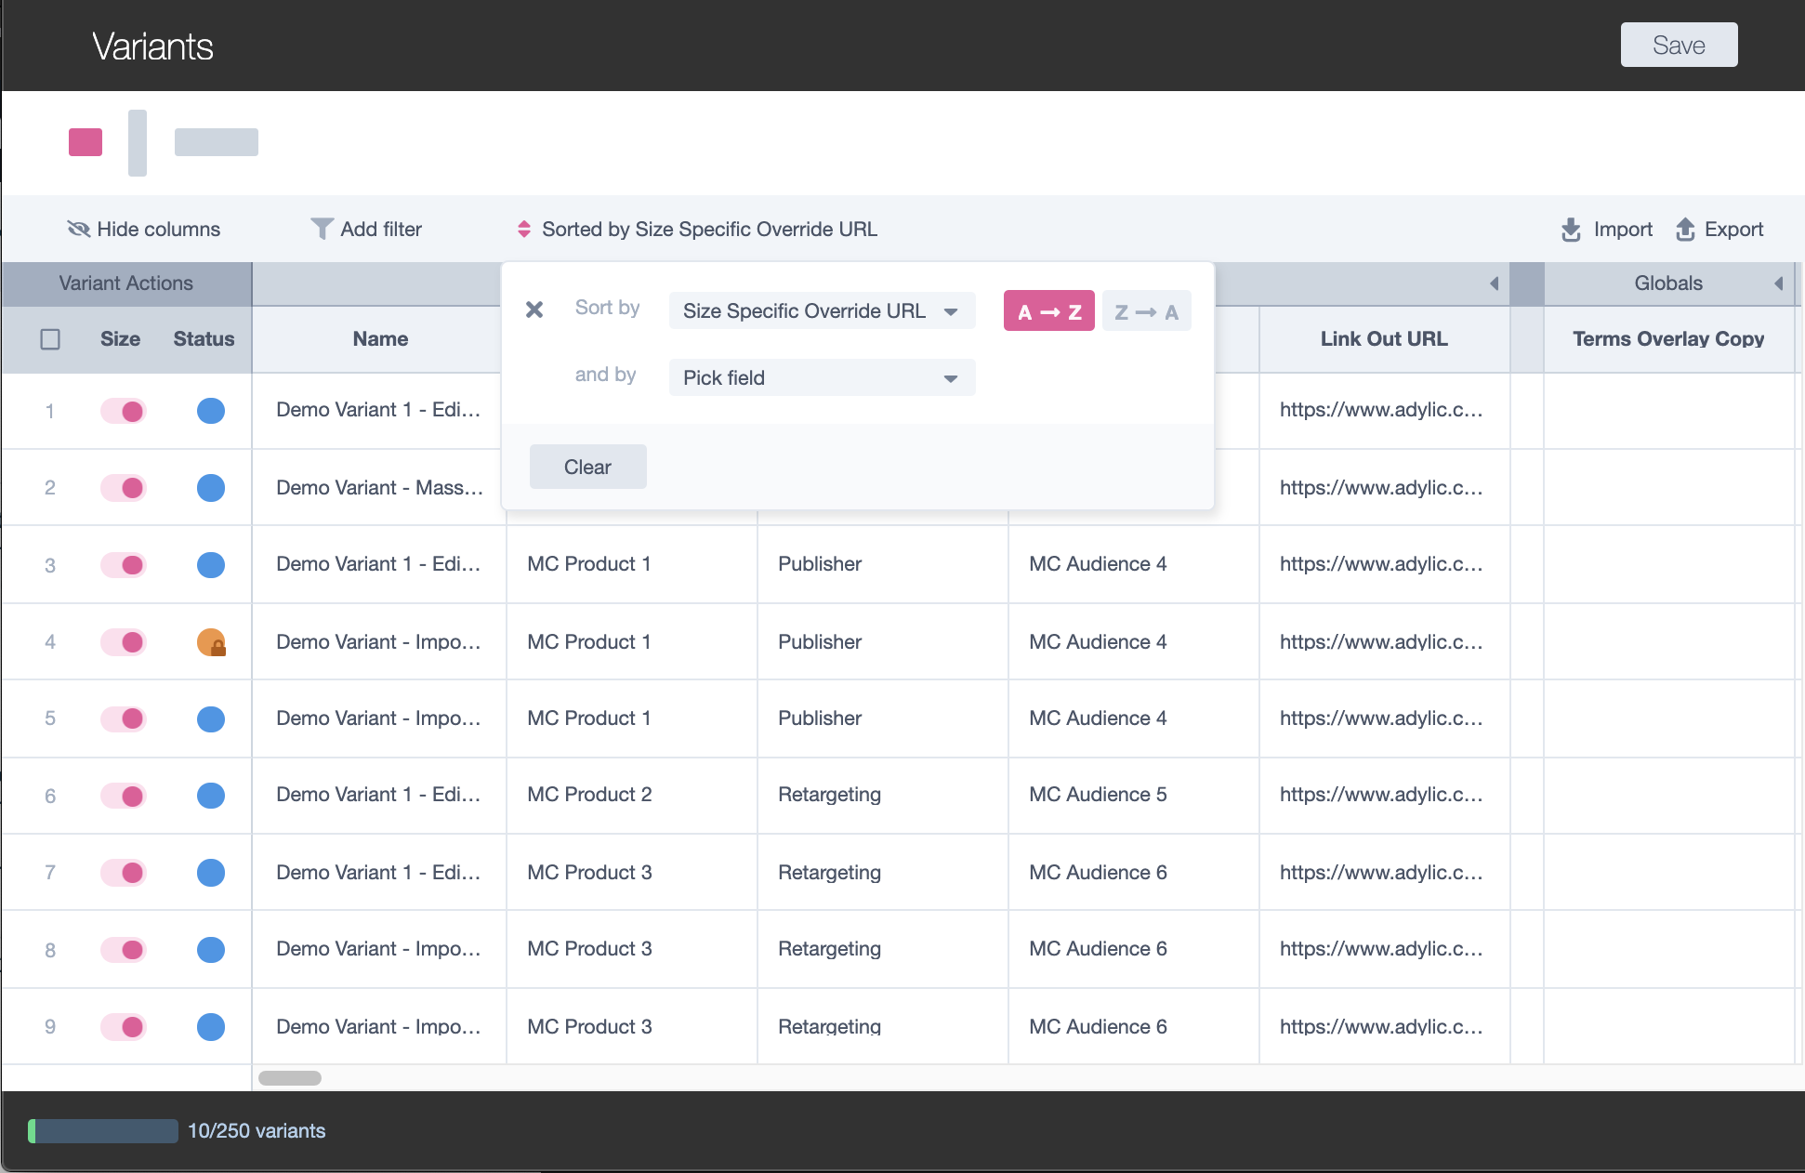
Mass Create Grid View
Full user guide &
video available!
Filtering & Sorting
Sorting:
Go to the ‘Sort’ button in the headline actions bar to open the Sort panel
Open the ‘Select Field’ option and scroll through the list of column headings to find the field containing the values you would like to sort by
Select this field and see two order options* appear:
  A > Z (alphabetical)
  Z > A (Reverse alphabetical)
Select the order option that suits your needs and the rows in the grid will rearrange to match your selection from top to bottom.
NOTE: If you select a numerical field, you will instead see ‘1>9’ or ‘9>1’ order options.
1
2
3
4

Slide 15
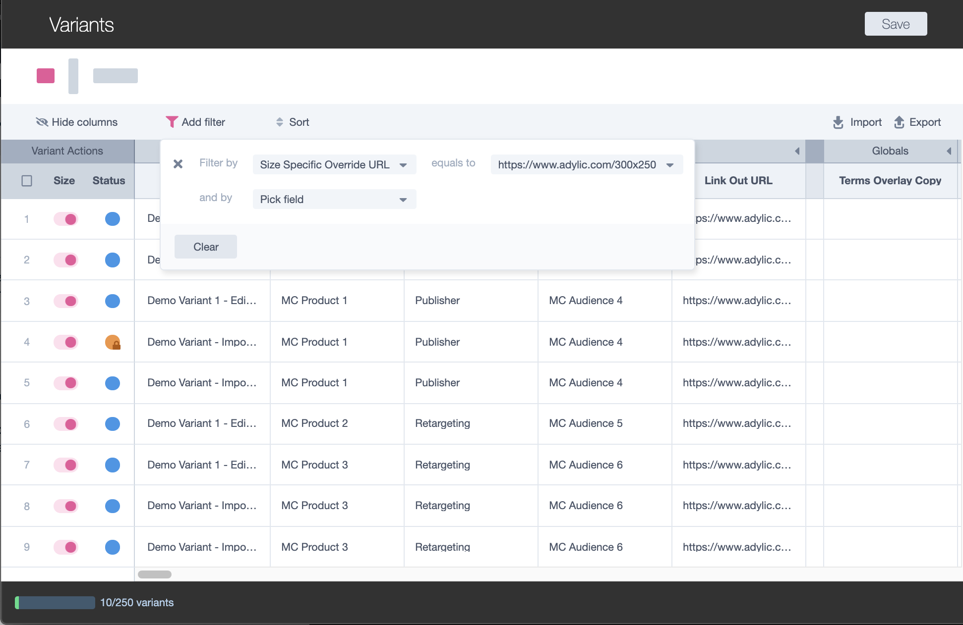
Mass Create Grid View
Full user guide &
video available!
Filtering & Sorting
Filtering:
Go to the ‘Filter’ button in the headline actions bar to open the Filter panel
Open the ‘Select Field’ option and scroll through the list of column headings to find the field containing the values you would like to filter by
Select this field and see an ‘equals to’ option
Select the equals to option to then scroll through the values contained within the column field you selected
Select the value in the list against which you want to filter by and see your rows in the grid have been reduced down to only show those contained
1
2
3
4

Slide 16
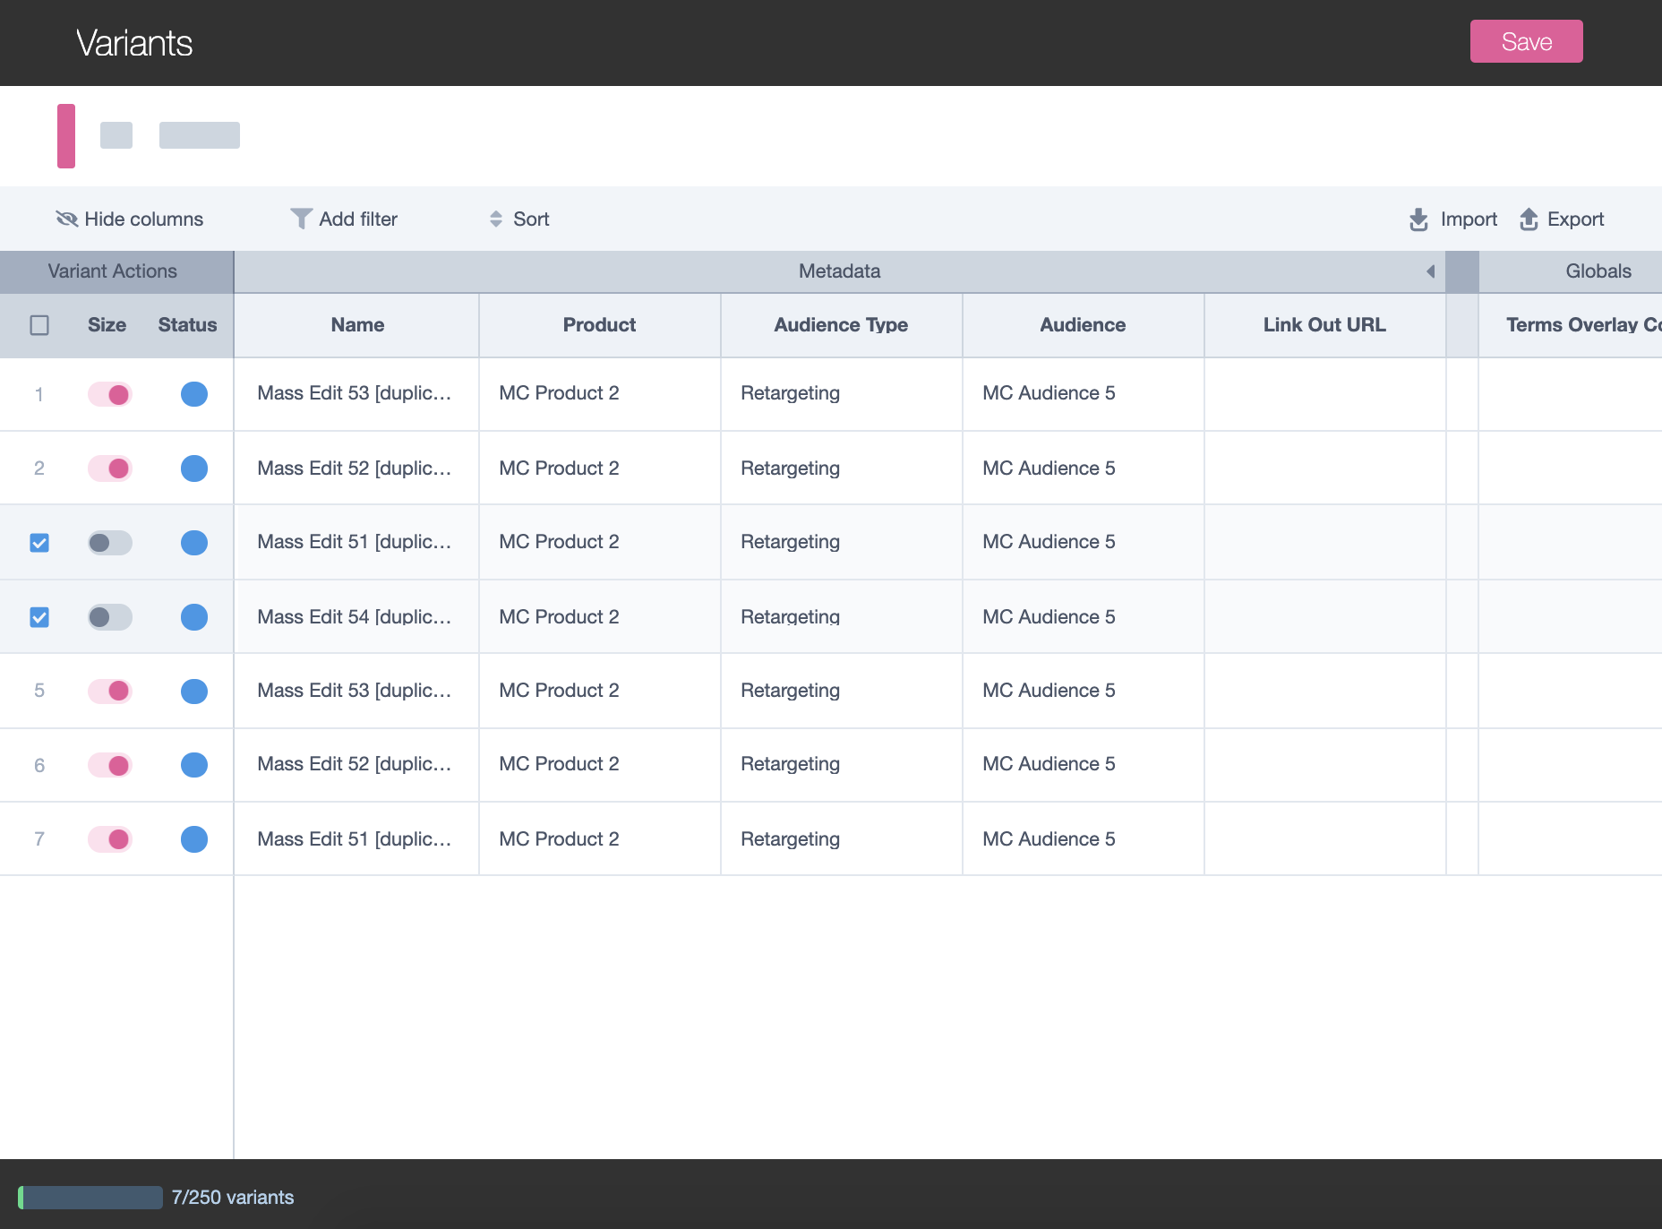
Mass Create Grid View
Full user guide &
video available!
Variant Sizes
Variants are collections of sizes, as you will be now used to from working in the Orca Editor. So it’s important to note that the tables are split by size* to make your editing mode more manageable.
Switching Sizes: The variant sizes feature above the grid shows you which creative size you are working on. To change to a new size, click on a different size and then continue working in the grid.
Enabling/Disabling Sizes: The Size ON/OFF feature on the left of the grid, allows you to enable/disable certain sizes for your variants. Pink state shows the size is ON and Grey shows the size is OFF.
1
2
*Only the creative, size specific, data is split into different tables. Metadata applies to the whole variant and so is actually shared across all size tables. Please see the ‘Metadata vs. Creative Data’ FAQ for more info.
TIP

Slide 17
Mass Create Grid View
Full user guide &
video available!
CSV Working Offline
For users that prefer working in Excel, the grid has an offline working mode where you can export the table into a CSV, make the desired changes to the variants and then import the changes into the grid. The first step is exporting the files:
Part 1: Exporting
Click the ‘Export’ button on the right hand side of the headlines action bar
This should have triggered an automatic* download of two files you will need for editing variant offline:
  Variant File: mycreative.csv
  Audience Dictionary File: mycreative_dictionary.csv
1
*Some browsers automatically block pop-ups or multiple downloads, so if you don’t see both files download automatically you should check whether your settings are blocking this. (Most browsers will make this obvious to you in the UI; for example, Chrome will show you a big message asking if you want to allow multiple downloads. You should say ‘Yes’!)
TIP
2

Slide 18
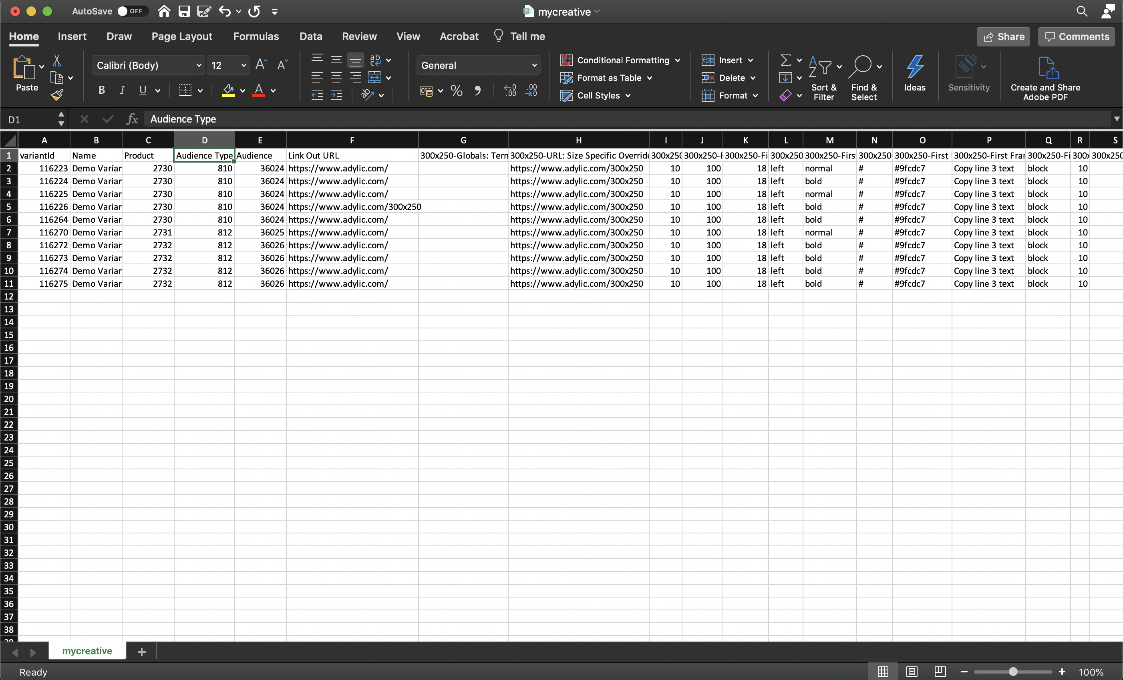
Mass Create Grid View
Full user guide &
video available!
1
CSV Working Offline
The next step is editing the CSV file with the updates you want to make to your variant:
Part 2: Editing
Open the Variant File (mycreative.csv) in Excel
You should see a table that looks very familiar, with the same structure as the grid:
  Columns = Editable Data Fields
  Rows = Variants
The main differences you will need to be aware of when working in CSV:
  Products, Audience Type and Audiences are inputted as IDs, which can all be found in the Audience Dictionary File (mycreative_dictionary.csv)
  All sizes are represented in one file (not split into separate tables) with each size’s editable fields labelled in the column headings
2
3b
3a
Offline working is currently only supported for editing existing variants (i.e each row will need a valid ‘Variant ID’) for a successful import. Therefore, you should create and duplicate (if needed) your set of variants in the grid first then export the file to work in Excel!
TIP

Slide 19
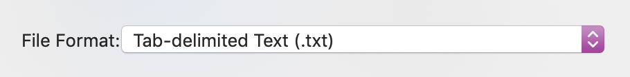
Mass Create Grid View
Full user guide &
video available!
CSV Working Offline
Final step; importing your updates to the grid!
Part 3: Importing
Once you’ve finished your work in Excel, you should save your file in a Tab Delimited Text (.txt ) format*
Then, go back to your MC session and select ‘Import’
From here, you should pick your saved Variant File (mycreative.txt) from your documents and select ‘Open’
If all changes made in the Excel sheet are valid you will see a message to confirm your changes were successful and you should see your updates reflected in the grid!
If you made some changes that were un-successful, you will be presented with a list of errors to address
  NOTE: All updates imported without an error/invalid value should still be updated in the grid
  You only need to readdress the variants with errors listed. This can be done directly in the grid or through offline working; whichever you prefer!
1
*To save your file in a new format in Excel, you will need to go to:
File > Save As > File Format > Speciality Formats > Tab Delimited Text
TIP

Slide 20
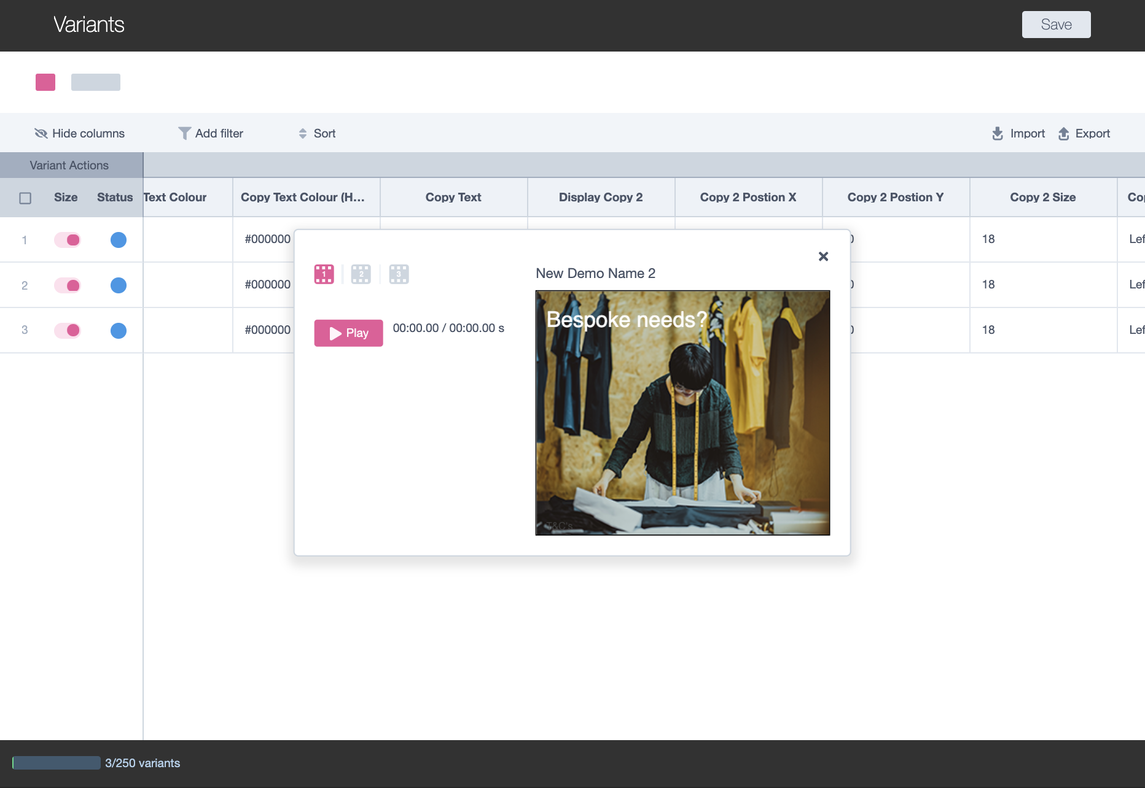
Mass Create Grid View
Full user guide &
video available!
Previewing
Whilst working in the grid, there will be times when you want to see what the changes you have made actually look like! For this, you can open the Preview Panel:
Whilst anywhere in the application, hit ‘Alt’+’P’ or ‘Option’+’P’
This will open a window over your grid, showing you the first variant in your table
Press the ‘Play’ button to play the variant from start to finish
Select a frame icon to view a frame individually
Use your ‘left’ and ‘right’ arrow keys to view the different sizes for your variant
Use the ‘up’ and ‘down’ arrow keys to move through the table to a different variant
To close the Preview, hit the “Esc” key or use the close button
7
4
3
In Preview mode, you are viewing the saved version of your variant. If you have unsaved changes in the grid, you should save before opening the preview window. Please see the ‘Saving’ FAQ for more info.
TIP

Slide 21
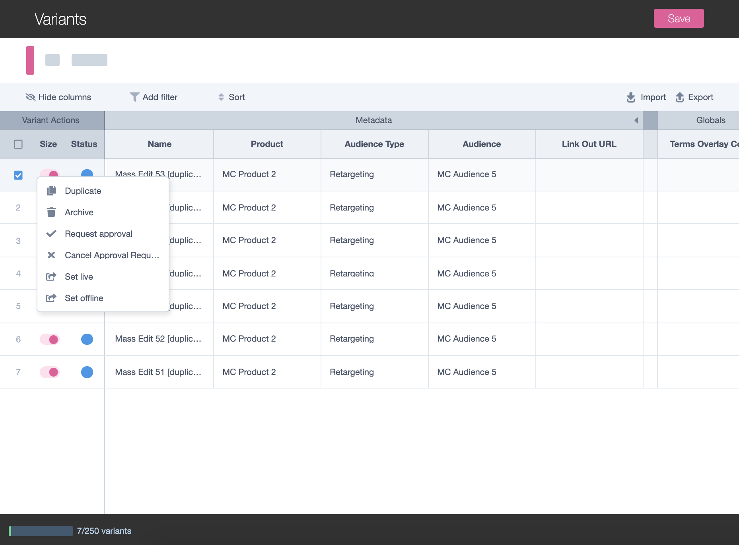
Mass Create Grid View
Saving & Managing Variants
1
So, once you’ve done all your editing in the grid, you’ll want to make sure everything is managed correctly. There’s a number of variant actions to focus on here:
Saving:
  To save your work, there is a ‘Save’ button in the navigation bar
  Pressing ‘Save’ will save all unsaved changes across the whole table of variants
  You will know you need to save if the button is in the pink active state
  It is important you save your work as you go, to avoid losing anything!
Variant Actions:
  On the left of the grid, there is a ‘Variant Action’ panel
  Here you can right click on a single or multiple variants to perform your usual actions:
    Request Approval
    Cancel Approval Request
    Set Live
    Set Offline
    Archive
2a
2b

Slide 22
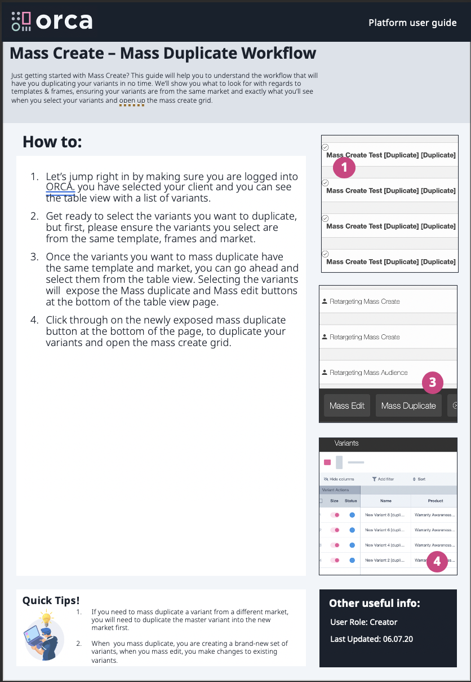
User Resources & Support
Additional Resources
As mentioned at the beginning of the document, we have also created more detailed ‘How To’ guides and videos for the different parts of the process!
The suite of available resources is as follows:
ORCA_Mass Create_How to Mass Duplicate
ORCA_Mass Create_How to Mass Edit
ORCA_Mass Create_How to Manage Columns
ORCA_Mass Create_How to Manage Sizes
ORCA_Mass Create_How to Preview
ORCA_Mass Create_How to Sort and Filter
ORCA_Mass Create_How to work in CSV
If you don’t already have any of these documents, please let your Adylic Account Manager know and they will share everything with you!

Slide 23

User Resources & Support
Reporting a Problem
With any technology, there is always a possibility we run into bugs and so we want to make sure you know where to go, and what to do, for us to resolve things quickly!
If something doesn’t look right, please email your Adylic Account Manager, with the following information:
ORCA URL link of the page affected e.g https://orca.adylic.com/masscreate?ids=115668827&action=DUPLICATE
Description of the observed behaviour e.g. “Mass Create grid is not showing my previews correctly. I update the ‘Copy’ field on ’Variant 1’ but my changes are not reflected in the player…”
Screenshots e.g [Screenshot of Chrome browser showing mass create grid with the updated Copy cell value in view] and [Screenshot showing the grid with the preview player open, where the wrong copy value is shown in the player]
Device and Browser details e.g MacBook Pro 10.14.5 (18F132), Chrome Version 74.0.3729.169 (Official Build) (64-bit)
From here, your Adylic Account Manager will raise it with our technical team to quickly identify, replicate and resolve the issue for you!

